Slide 1


Data
Analysis

Slide 2


Today's agenda
Project recap
Problem
The Analytics team
Process
Insights
Summary

Slide 3

Social Buzz a unicorn company growing and need to adapt quickly to global scale
Accenture has begun 3 months POC for following tasks:
Audit of Social Buzz’s big data practice
Recommendations for a successful IPO
Analysis to find Social Buzz’s top 5 most popular categories of content
Project Recap

Slide 4

Problem
100000+ posts per day
3,65,00,000 posts per year
But how to Capitalize on it when there is so much?
Analysis to find Social Buzz’s top 5 most popular categories of content

Slide 5



ANDREW FLEMING
Chief Technology Architect
The Analytics team
MARCUS ROMPTON
Senior Principal
ABHISHEK AWARE
DATA ANALYST

Slide 6
Data Understanding
Process
1
Data Cleaning
2
Data Modelling
3
4
Data Analysis
5
Uncover Insights

Slide 7


Insights
16
Unique Categories
Animal
Most Favorite Category
May
Month with
Most Number of posts
Notes:
From your data we found that you had a total of 16 unique categories of posts across your sample dataset. This includes things such as Food, Culture and Sport.
As well as this, there was 1091 posts from just the Food category alone! People obviously really like food!
And also the most common month for users to post within was December, since this is such a seasonal month with so many holidays and events, this is interesting to know that people are most active during this month!
But now, onto the main question... which is... what were the top 5 most popular categories of posts?

Slide 8
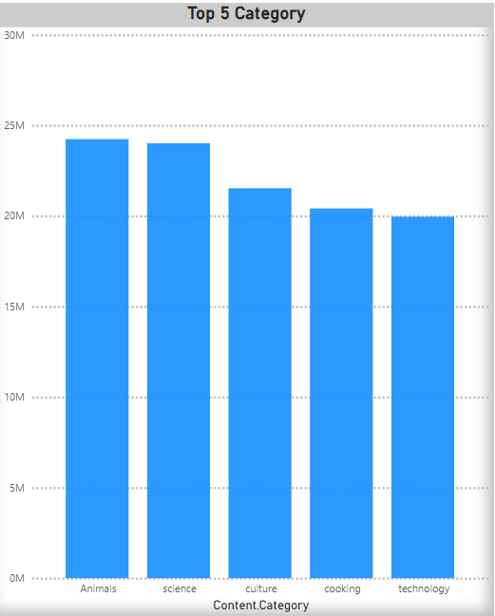

Slide 9
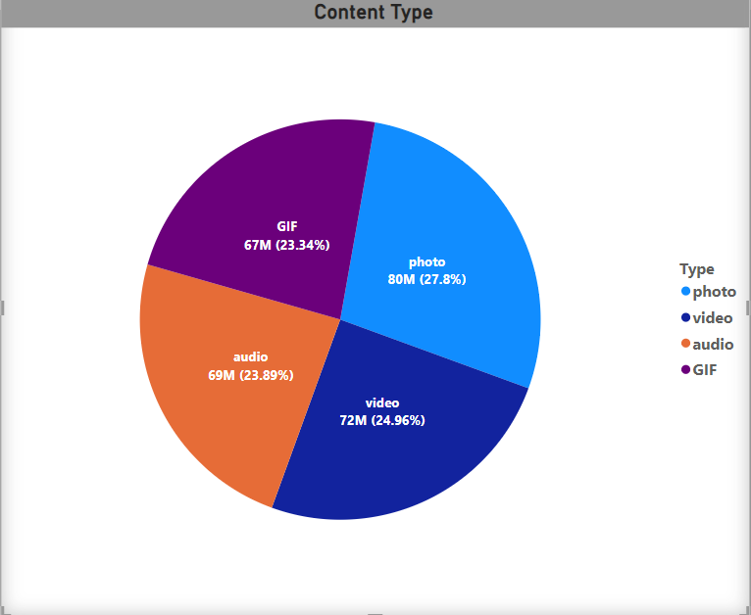

Slide 10

ANALYSIS
Science and Technology are the most popular categories of content showing that people enjoy “real-life” and “factual” content the most.
Summary
INSIGHT
Food is a common theme with the top 5 Categories with “Science” ranking the highest. This may give an indication to the audience within your user base. You could use the insight to create a campaign and work with healthy eating brands to boots user engagement.
NEXT STEPS
This ad-hoc analysis is insightful, but it’s time to take this analysis into large scale production for real-time understanding of your business. We can show you how to do this.

Slide 11
Thank you!
ANY QUESTIONS?

